Slide 1
Assessing the Sensitivity to Thermal Stress of Caribbean Reefs Following Recent Global Bleaching Events Benjamin Kon SUR5386 – Image Processing and Remote Sensing 4/25/2018

Slide 2
Roatan, Honduras, 2011 – Photo by Benjamin Kon

Slide 3
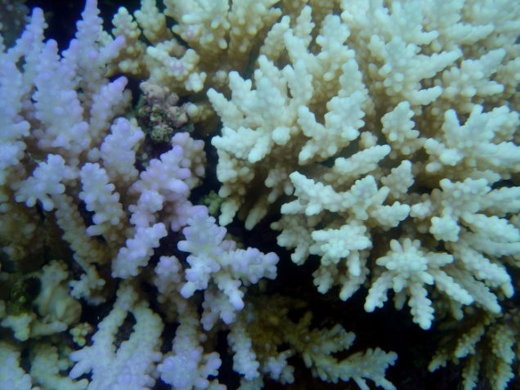
Problem and Relevant Literature
The “longest, most widespread, and probably most damaging coral bleaching event on record” (CRW 2018) is also the most recent, spanning from 2014-2017.
Reefs throughout the globe have been impacted and the extent of the damage is still being assessed in many places.
Coral bleaching results from the expulsion of symbiotic micro-algae which “reside in the coral's tissue and provide metabolic products necessary for coral survival” (Claar et al. 2017)
Coral Bleaching.
Photo by David Burdick, courtesy of NOAA

Slide 4
Problem, continued.
The “causative link between increased temperatures and mass coral bleaching” (Hedley et al. 2016) signifies that risk of bleaching may be effectively monitored using remote sensing products which measure sea surface temperature (SST).
In a 2010 Directory of Remote Sensing Applications for Coral Reef Managment, Peter J. Mumby outlines a method of categorizing corals’ sensitivity based on their experience of chronic and acute thermal stress.

Slide 5
Methodology
Chronic Stress
Mumby defines chronic stress in terms of the “Maximum Monthly Mean during non-bleaching years” (Mumby et al. 2010).
The U.S. National Oceanic and Atmospheric Administration has released an updated 5-km resolution climatology product, including maximum monthly mean, improving on data from its earlier PATHFINDER products by reanalysis using data from the U.K.’s OSTIA system. The dataset and further description can be found here: https://coralreefwatch.noaa.gov/satellite/bleaching5km/index.php

Slide 6
Methodology, continued
Acute Stress
Acute thermal stress is “quantified for any given bleaching event as the maximum Degree Heating Weeks [DHW] experienced” (Mumby et al. 2010)
NOAA’s Coral Reef Watch recently released its “Daily Global 5km Satellite Coral Bleaching Heat Stress Monitoring” products suite, which includes annual composite map images for DHW. However, the data for the composite product seems not to be available yet.
Since reproducing the composite using all of the daily DHW values would seem beyond the scope of this study, a representative date was used to apply the categorization. The date chosen was 11/30/2016, based on CRW’s description of bleaching during 2016 when “heat stress then brought bleaching back to the western Atlantic, Gulf of Mexico, and Caribbean from September through November” (CRW 2018)

Slide 7
Creation of Spatial Subsets
Global datasets for Maximum Monthy Mean SST and Degree Heating Weeks were loaded into Excelis ENVI and spatial subsets with equivalent pixel ranges were created.
Maximum Monthly Mean SST 2016
DHW recorded on 11/30/2016 near the end of 2016 bleaching event.

Slide 8
ROIs Defined Using Thresholds Determined by Statistics.
Statistics were computed for each dataset using masking to filter out values for land masses and areas experiencing less than 1 Degree Week Heating. Following Mumby’s suggestion, thresholds were created marking the upper and lower third of the filtered data. The thresholds were then used to compute regions of interest.
High (red) and Low (blue) Chronic Stress
High (magenta) and Low (cyan) Acute Stress

Slide 9
Categories Formed by Intersecting ROIs
Four categories described by Mumby were formed by intersecting regions of interest. The results (and key) are shown below.
High Chronic/Low Acute
High Chronic/ High Acute
Low Chronic/Low Acute
Low Chronic/High Acute

Slide 10
Discussion
Reefs experiencing high chronic thermal stress but low acute stress are considered most likely to survive a bleaching event, while those experiencing low chronic stress but high acute stress “fare worst” (Mumby et al. 2010).
The results of this study suggest that areas for concern at the end of 2016 may be found in reefs of the eastern Caribbean islands, those along the northern coast of South America (e.g. Bonaire), and those on the northern side of the Yucatan Peninsula.

Slide 11
Discussion, continued
The results seem somewhat inconsistent with CRW’s observations that the “western Caribbean [was] hit hardest” in Fall of 2016, while only “patchy bleaching was reported in the eastern Caribbean” (CRW 2018).
However, the fact that “Florida suffered only mild to moderate bleaching in summer 2016,” while “[m]oderate to severe bleaching…was reported in parts of the Mesoamerican Barrier Reef in October and November” does appear to coincide somewhat with the findings here.

Slide 12
Conclusion
The most recent global bleaching event is by far the longest to date, spanning a four-year time period. Therefore, to evaluate its impact and determine coral sensitivity using the methods applied herein should require more comprehensive composite data to determine Maximum Degree Heating Weeks.
However, this study does show the facility with which remote sensing data can be used for classifying reef systems according to their experience of thermal stress. As bleaching events are expected to continue to increase with the progression of global warming trends, such methods may be the most suitable for rapid coral reef evaluation to inform managers and conservationists during such events.

Slide 13
References
Claar, D. C., Szostek, L., Mcdevitt-Irwin, J. M., Schanze, J. J., & Baum, J. K. (2018). Global patterns and impacts of El Niño events on coral reefs: A meta-analysis. Plos One, 13(2). doi:10.1371/journal.pone.0190957
Hedley, J., Roelfsema, C., Chollett, I., Harborne, A., Heron, S., Weeks, S., . . . Mumby, P. (2016). Remote Sensing of Coral Reefs for Monitoring and Management: A Review. Remote Sensing, 8(2), 118. doi:10.3390/rs8020118
Mumby, P., Christensen, T., Chollett, I., Hedley, J., Bejarano, S., Skirving, W., & Strong, A. (2010). Directory of Remote Sensing: Applications for Coral Reef Management. University Of Queensland: University of Queensland - Centre for Marine Studies - Coral Reef Targeted Research & Capacity Building for Management Program. Retrieved from http://ccres.net/images/uploads/publications/4/crtr_-_rs_directory_web_5_final_upd.pdf
NOAA. (March 18, 2018). Coral Bleaching During & Since the 2014-2017 Global Coral Bleaching Event Status and an Appeal for Observations. Retrieved from https://coralreefwatch.noaa.gov/satellite/analyses_guidance/global_coral_bleaching_2014-17_status.php

Slide 14
References, continued
NOAA. (October 17, 2011). NOAA Coral Reef Watch Methodology, Product Description, and Data Availability of NOAA Coral Reef Watch (CRW) Operational and Experimental Satellite Coral Bleaching Monitoring Products . Retrieved from https://coralreefwatch.noaa.gov/satellite/analyses_guidance/global_coral_bleaching_2014-17_status.php
NOAA Coral Reef Watch. (2017, updated daily). NOAA Coral Reef Watch Daily Global 5km Satellite Coral Bleaching Heat Stress Monitoring Climatologies Product v. 3, 1985-2012. College Park, Maryland, USA: NOAA Coral Reef Watch. Data set accessed 2018-04-21 at ftp://ftp.star.nesdis.noaa.gov/pub/sod/mecb/crw/data/5km/v3/climatology/data/
NOAA Coral Reef Watch. (2018, updated daily). Daily Global 5km Satellite Coral Bleaching Heat Stress Monitoring Degree Heating Week product, 2016-11-30. College Park, Maryland, USA: NOAA Coral Reef Watch. Data set accessed 2018-04-21 at ftp://ftp.star.nesdis.noaa.gov/pub/sod/mecb/crw/data/5km/v3.1/nc/v0.1/daily/dhw/2016/

